Slide 1

Support Vector Machines

Slide 2


Support Vector Machines
Remember the general flow of a machine learning problem:
Divide dataset into training and test samples
Train the model using training dataset
Test using sample training data
Performance metrics (Finalize the model)
Improve the model using error analysis
There can be several models depending on the problem statement
We will discuss about one such model - SVM

Slide 3
Support Vector Machines
Support vector machine is
Very powerful and versatile model
Capable of performing
Linear and
Nonlinear classification
Regression and
Outlier detection
Well suited for small or medium sized datasets

Slide 4
Support Vector Machines
In this session we will learn about
Linear SVM Classification
Nonlinear SVM Classification and
SVM Regression

Slide 5
Support Vector Machines
Linear SVM Classification

Slide 6







What is Classification?
Supervised
Classification
Regression
Human Supervision?
Unsupervised
Reinforcement
Machine Learning
Learn Incrementally?
How they generalize?
Machine Learning

Slide 7
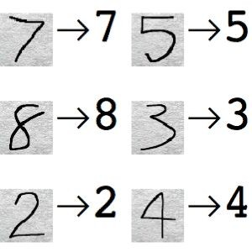



What is Classification?
Identifying to which label something belongs to
5
Not 5

Slide 8
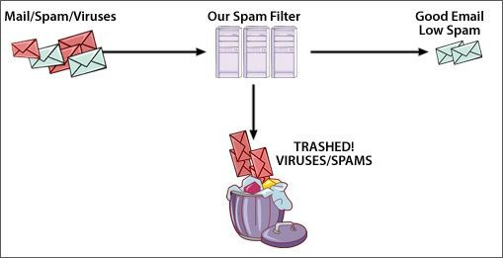
Examples of Classification
Classifying emails as spam or not spam
Q. What type of classification is this?

Slide 9
Examples of Classification
Classifying emails as spam or not spam
Q. What type of classification is this? Ans: Binary

Slide 10
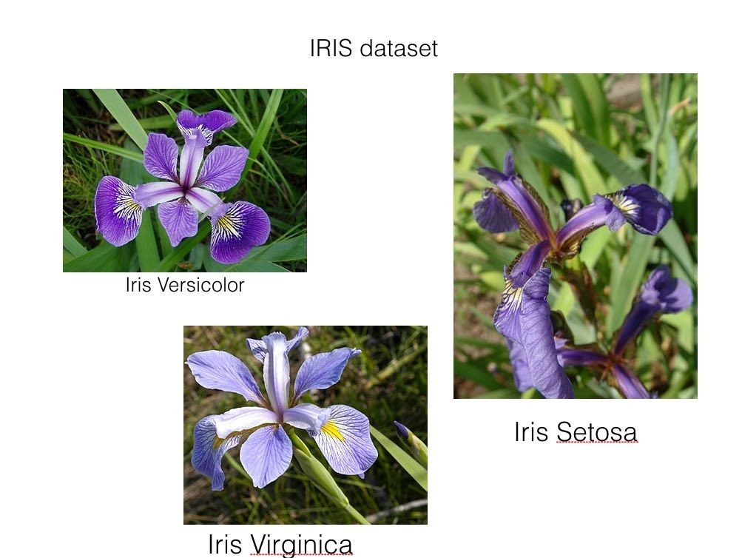
Examples of Classification
Classifying flowers of a particular species like the Iris Dataset
Q. What type of classification is this?

Slide 11
Examples of Classification
Classifying flowers of a particular species like the Iris Dataset
Q. What type of classification is this? Ans: Multi-class classification

Slide 12

Examples of Classification
Classifying a credit card transaction as fraudulent or not

Slide 13
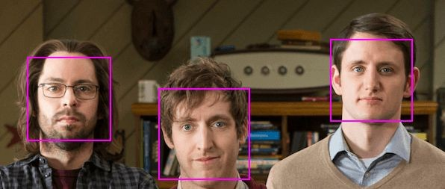
Examples of Classification
Face recognition
Q. What type of classification is this?

Slide 14
Examples of Classification
Face recognition
Q. What type of classification is this? Ans: Multi-label classification

Slide 15
Recap of 5 and Not 5 Classification Problem
Binary Classification
Multiclass Classification
5
Not 5
Q. What is the classifier we used for the Binary Classification?

Slide 16
Recap of 5 and Not 5 Classification Problem
Binary Classification
Multiclass Classification
5
Not 5
Q. What is the classifier we used for the Binary Classification? Ans: SGDClassifier

Slide 17
Recap of 5 and Not 5 Classification Problem
Binary Classification
Multiclass Classification
5
Not 5
Q. What is the classifier we used for the Multiclass Classification?

Slide 18
Recap of 5 and Not 5 Classification Problem
Binary Classification
Multiclass Classification
5
Not 5
Q. What is the classifier we used for the Multiclass Classification? Ans: SGDClassifier - OvO and OvA

Slide 19
What is Linear Classification?

Slide 20
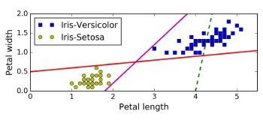
What is Linear Classification?
The two classes can be separated easily with a ‘straight’ line
‘Straight’ is the keyword. It means linear classification.

Slide 21
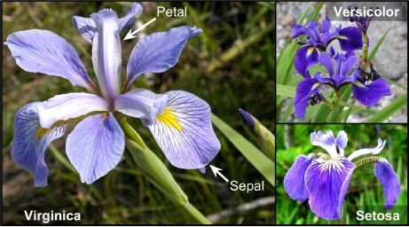
What is Linear Classification?
For example: IRIS Dataset
Features: Sepal Length, Petal Length
Class: Iris Virginica OR Iris Versicolor OR Iris Setosa

Slide 22
What is Linear Classification?
Sepal Length | Petal Length | Flower Type
1.212 | 4.1 | Iris-Versicolor
0.5 | 1.545 | Iris-Setosa
0.122 | 1.64 | Iris-Setosa
0.2343 | ... | Iris-Setosa
0.1 | ... | Iris-Setosa
1.32 | ... | Iris-Versicolor

Slide 23
What is Linear Classification?
For the above IRIS Dataset, what is the type of Machine Learning model?
Classification or Regression?
Ans:

Slide 24
What is Linear Classification?
For the above IRIS Dataset, what is the type of Machine Learning model?
Classification or Regression?
Ans: Classification

Slide 25
What is Linear Classification?
What is the type of Supervised Machine Learning model?
Classification or Regression?
Ans: Classification
What type of classification?
Binary Classification
Multi-label Classification
Multi-output Classification
Multi-class Classification

Slide 26
What is Linear Classification?
What is the type of Supervised Machine Learning model?
Classification or Regression?
Ans: Classification
What type of classification?
Binary Classification
Multi-label Classification
Multi-output Classification
Ans: Multi-class Classification

Slide 27
What is Linear Classification?
For the IRIS dataset above:
Number of features?
Ans:
Number of classes?
Ans:

Slide 28
What is Linear Classification?
For the IRIS dataset above:
Number of features?
Ans: 2
Number of classes?
Ans: 3

Slide 29
What is Linear Classification?
When we plot the two features on the graph and label it by color
The classes can be divided using a straight line
Hence, linear classification
Straight Line (Linear Classification)

Slide 30
Linear SVM Classification
Linear SVM Classification
Nonlinear SVM Classification
SVM
Regression
Bad model
versus good-model
(Large Margin) Classification
Soft Margin versus
Hard-margin Classification

Slide 31
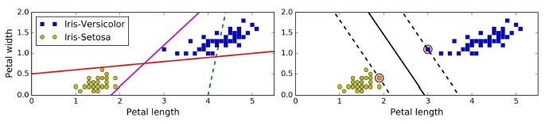


Linear SVM Classification - Large Margin
Pink and red decision boundaries are very close to the instances - bad model
Decision Boundary as far away from training instances - good model
Widest possible street
Large Margin Classification

Slide 32
Linear SVM Classification - Large Margin
May not perform well on new instances
Adding training instances may not affect the decision boundary
Large Margin Classification

Slide 33
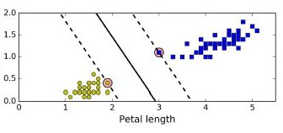


Linear SVM Classification - Large Margin
What are Support vectors?
Vectors or the training set located closest to the classifier OR
Vectors or the training sets located at the edge of the street
Widest possible street
Large Margin Classification
Support Vectors

Slide 34


Switch to Notebook

Slide 35
Linear SVM Classification - Example 1
Without Scaling
Training dataset
X1 | X2 | Label
1 | 50 | 0
5 | 20 | 0
3 | 80 | 1
5 | 60 | 1

Slide 36
Linear SVM Classification - Example 1
Model the classifier, plot the points and the classifier
>>> Xs = np.array([[1, 50], [5, 20], [3, 80], [5,
60]]).astype(np.float64)
>>> ys = np.array([0, 0, 1, 1])
>>> svm_clf = SVC(kernel="linear", C=100)
>>> svm_clf.fit(Xs, ys)
>>> plt.plot(Xs[:, 0][ys==1], Xs[:, 1][ys==1], "bo")
>>> plt.plot(Xs[:, 0][ys==0], Xs[:, 1][ys==0], "ms")
>>> plot_svc_decision_boundary(svm_clf, 0, 6)
>>> plt.xlabel("$x_0$", fontsize=20)
>>> plt.ylabel("$x_1$ ", fontsize=20, rotation=0)
>>> plt.title("Unscaled", fontsize=16)
>>> plt.axis([0, 6, 0, 90])

Slide 37
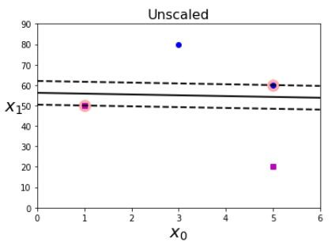
Linear SVM Classification - Example 1
Model the classifier, plot the points and the classifier

Slide 38
Linear SVM Classification - Example 1
What is the problem?

Slide 39
Linear SVM Classification - Example 1
What is the problem?
X0 ranges from 0 to 6 while
X1 ranges from 20 to 80
Solution: Feature Scaling

Slide 40
Feature Scaling
Feature Scaling
Quick Revision from
Preparing the data for ML Algorithms in End-to-End Project
Machine Learning Project

Slide 41
Feature Scaling
ML algorithms do not perform well
When the input numerical attributes have very different scales
Feature Scaling is one of the most important
Transformation we need to apply to our data
Two ways to make sure all attributes have same scale
Min-max scaling
Standardization
Machine Learning Project

Slide 42
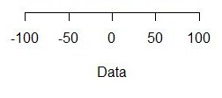

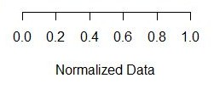
Feature Scaling
Min-max Scaling
Also known as Normalization
Normalized values are in the range of [0, 1]
Machine Learning Project

Slide 43



Feature Scaling
Min-max Scaling
Also known as Normalization
Normalized values are in the range of [0, 1]
Original Value
Normalized Value
Machine Learning Project

Slide 44
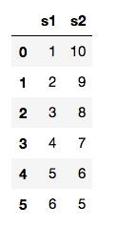
Feature Scaling
Min-max Scaling - Example
# Creating DataFrame first
>>> import pandas as pd
>>> s1 = pd.Series([1, 2, 3, 4, 5, 6], index=(range(6)))
>>> s2 = pd.Series([10, 9, 8, 7, 6, 5], index=(range(6)))
>>> df = pd.DataFrame(s1, columns=['s1'])
>>> | df['s2'] | = | s2
>>> | df
Machine Learning Project

Slide 45

Feature Scaling
Min-max Scaling - Example
# Use Scikit-Learn minmax_scaling
>>> from mlxtend.preprocessing import minmax_scaling
>>> minmax_scaling(df, columns=['s1', 's2'])
Original
Scaled (In range of 0 and 1)
Machine Learning Project

Slide 46
Feature Scaling
Standardization
In Machine Learning, we handle various types of data like
Audio signals and
Pixel values for image data
And this data can include multiple dimensions
Machine Learning Project

Slide 47
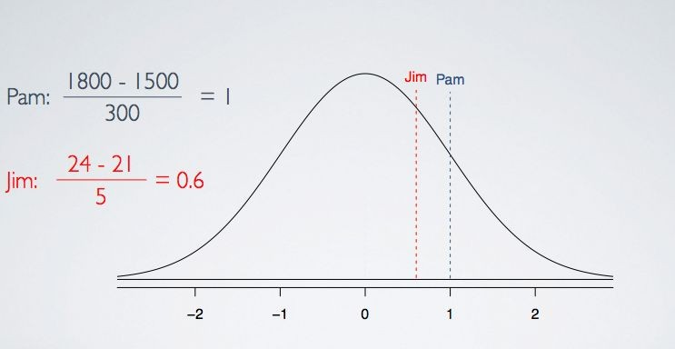
Feature Scaling
Standardization
We scale the values by calculating
How many standard deviation is the value away from the mean SAT scores ~ N(mean = 1500, SD = 300)
ACT scores ~ N(mean = 21, SD = 5)
Machine Learning Project

Slide 48


Feature Scaling
Standardization
The general method of calculation
Calculate distribution mean and standard deviation for each feature
Subtract the mean from each feature
Divide the result from previous step of each feature by its standard deviation
Standardized Value
Machine Learning Project

Slide 49



Feature Scaling
Standardization
In Standardization, features are rescaled
So that output will have the properties of
Standard normal distribution with
Zero mean and
Unit variance
Mean
Standard Deviation
Machine Learning Project

Slide 50
Feature Scaling
Standardization
Scikit-Learn provides
StandardScaler class for standardization
Machine Learning Project

Slide 51
Feature Scaling
Which One to Use?
Min-max scales in the range of [0,1]
Standardization does not bound values to a specific range
It may be problem for some algorithms
Example- Neural networks expect an input value ranging from 0 to 1
We’ll learn more use cases as we proceed in the course
Machine Learning Project

Slide 52
Feature Scaling
Back to original Example 1
Machine Learning Project

Slide 53
Linear SVM Classification - Example 2
With Scaling
x1 | x2 | Label | x1 (Scaled) | x2 (Scaled)
1 | 50 | 0 | -1.5 | -0.1154
5 | 20 | 0 | 0.9 | -1.5011107
3 | 80 | 1 | -0.3 | 1.27017
5 | 60 | 1 | 0.9 | 0.3464
Mean (m1) = 3.5 | Mean (m2) = 52.5 |  | (x-m1)/s1 | (x-s2)/m2
Std Dev (s1) | Std Dev (s2)
= 1.65 | = 21.65

Slide 54
Linear SVM Classification - Example 2
Scaling of features
X_new = (x-m1)/s1
What kind of scaling is this?
Normalization
Standardization

Slide 55

Linear SVM Classification - Example 2
Scaling of features
X_new = (x-m1)/s1
What kind of scaling is this?
Normalization
Standardization

Slide 56
Linear SVM Classification - Example 2
Scaling of features
X_new = (x-m1)/s1
What kind of scaling is this?
Normalization
Standardization
What is the module available in scikit_learn to perform standardization?

Slide 57
Linear SVM Classification - Example 2
Scaling of features
X_new = (x-m1)/s1
What kind of scaling is this?
Normalization
Standardization
What is the module available in scikit_learn to perform standardization?
Answer: StandardScalar

Slide 58
Linear SVM Classification - Example 2
Scaling the input training data
>>> from sklearn.preprocessing import StandardScaler
>>> scaler = StandardScaler()
>>> X_scaled = scaler.fit_transform(Xs)
>>> print(X_scaled)
[[-1.50755672 -0.11547005]
[ 0.90453403 -1.5011107 ]
[-0.30151134
[ 0.90453403
1.27017059]
0.34641016]]

Slide 59
Linear SVM Classification - Example 2
Building the model, plotting the decision boundary and the training points
>>> | svm_clf.fit(X_scaled, | ys)
>>> | plt.plot(X_scaled[:, | 0][ys==1], | X_scaled[:, | 1][ys==1], | "bo")
>>> | plt.plot(X_scaled[:, | 0][ys==0], | X_scaled[:, | 1][ys==0], | "ms")
>>> plot_svc_decision_boundary(svm_clf, -2, 2)
>>> plt.ylabel("$x_{1scaled}$", fontsize=20)
>>> plt.xlabel("$x_{0scaled}$", fontsize=20)
>>> plt.title("Scaled", fontsize=16)
>>> plt.axis([-2, 2, -2, 2])

Slide 60
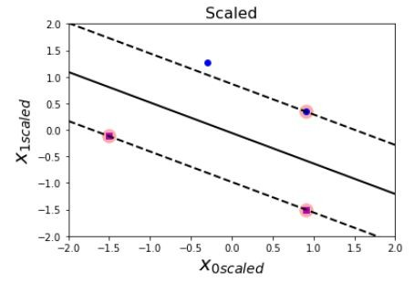
Linear SVM Classification - Example 2
Output decision boundary for a scaled training data

Slide 61
Linear SVM Classification
Unscaled vs Scaled comparison
X0 | X1 | Label | X0 (Scaled) | X1 (Scaled)
1 | 50 | 0 | -1.5 | -0.1154
5 | 20 | 0 | 0.9 | -1.5011107
3 | 80 | 1 | -0.3 | 1.27017
5 | 60 | 1 | 0.9 | 0.3464
Mean (m1) = 3.5 | Mean (m2) = 52.5 |  | (x-m1)/s1 | (x-m2)/s2
Std Dev (s1) | Std Dev (s2)
= 1.65 | = 21.65

Slide 62


Linear SVM Classification
Unscaled vs Scaled
Widest possible street

Slide 63
Linear SVM Classification
Unscaled vs Scaled
Linear SVM sensitive to scaling
Feature scaling an important part of data preparation
Normalization
Standardization
Scaled features produce better result for the above example

Slide 64
Switch to Notebook

Slide 65
Linear SVM Classification
Linear SVM Classification
Nonlinear SVM Classification
SVM
Regression
Bad model
versus good-model (Large Margin- Standardized) Classification
Soft Margin versus
Hard-margin Classification

Slide 66
Linear SVM Classification - Hard Margin
Hard Margin Classification
Strictly impose that all the instances should be
Off the street and
On a particular side of the decision boundary
Issues:
Works only if the data is linearly separable
Quite sensitive to outliers

Slide 67
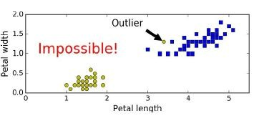
Linear SVM Classification - Hard Margin
Question - Is it possible to classify this using SVM Hard Margin Classification?
See the code in notebook

Slide 68
Linear SVM Classification - Hard Margin
Question - Is it possible to classify this using SVM Hard Margin Classification?
See the code in notebook

Slide 69
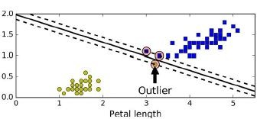
Linear SVM Classification - Hard Margin
Question - Is it possible to classify this using SVM Hard Margin Classification?
See the code in notebook

Slide 70
Linear SVM Classification - Hard Margin
Question - Is it possible to classify this using SVM Hard Margin Classification?
Answer - Yes, but what is the problem?
Yes
See the code in notebook

Slide 71
Linear SVM Classification - Hard Margin
Question - Is it possible to classify this using SVM Hard Margin Classification?
Answer - Yes, but what is the problem?
Outlier is the problem
Yes

Slide 72
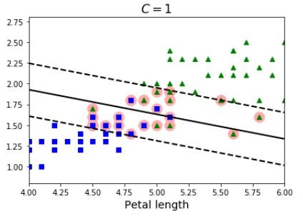
Linear SVM Classification - Soft Margin
Soft Margin Classification
Is keeping a balance between
Keeping the street as large as possible
Limiting the margin violations
Regulated by using ‘C’ parameter

Slide 73


Linear SVM Classification - Soft Margin
The balance can be regulated in Scikit-Learn using ‘c’ parameter
Higher ‘c’:
Narrower street, lower margin violations
Smaller ‘c’:
Wider street, more margin violations
>>> svm_clf = SVC(kernel="linear", C=100)
SVM Linear classification
‘C’ parameter to regulate the street and margin violations

Slide 74
Linear SVM Classification - Soft Margin
Example 1: SVM Classification for IRIS data using c = 1
Steps:
Load the IRIS data
Model the SVM Linear classifier with the training set: fitting
Test using a sample data
For illustration:
Plot the decision boundary and the training samples
Something missing in the steps?

Slide 75
Linear SVM Classification - Soft Margin
Example 1: SVM Classification for IRIS data using c = 1
Steps:
Load the IRIS data
Feature scaling the data
Model the SVM Linear classifier with the training set: fitting
Test using a sample data
For illustration:
Plot the decision boundary and the training samples
Something missing in the steps?

Slide 76
Switch to Notebook

Slide 77
Linear SVM Classification - Soft Margin
Example 1: SVM Classification for IRIS data using c = 1
Steps:
Load the IRIS data
>>> from sklearn import datasets
>>> | from | sklearn.pipeline import Pipeline
>>> | from | sklearn.preprocessing import StandardScaler
>>> | from | sklearn.svm import LinearSVC
>>> iris = datasets.load_iris()
>>> X = iris["data"][:, (2, 3)]
# petal length, petal width
>>> y = (iris["target"] == 2).astype(np.float64) # Iris-Virginica

Slide 78
Linear SVM Classification - Soft Margin
Example 1: SVM Classification for IRIS data using c = 1
Steps:
Load the IRIS data
Feature scaling the data
Model the SVM Linear classifier with the training set: fitting
>>> scaler = StandardScaler()
>>> svm_clf2 = LinearSVC(C=1, loss="hinge")
>>> scaled_svm_clf2 = Pipeline((("scaler", scaler), ("linear_svc", svm_clf2), ))
>>> scaled_svm_clf2.fit(X, y)

Slide 79
Linear SVM Classification - Soft Margin
Example 1: SVM Classification for IRIS data using c = 1
Steps:
Load the IRIS data
Feature scaling the data
Model the SVM Linear classifier with the training set: fitting
Test using a sample data
>>> scaled_svm_clf1.predict([[5.5, 1.7]])
array([ 1.])

Slide 80
Linear SVM Classification - Soft Margin
Example 1: SVM Classification for IRIS data using c = 1
Illustration:
Plot the decision boundary along with the training data
Convert to unscaled parameters
Training data and decision boundary as calculated
Find support vectors
Plot it on the graph

Slide 81
Linear SVM Classification - Soft Margin
Example 1: SVM Classification for IRIS data using c = 1
Illustration:
Plot the decision boundary along with the training data
Convert to unscaled parameters
# Convert to unscaled parameters
>>> svm_clf1.intercept_ = np.array([b2])
>>> svm_clf1.coef_ = np.array([w2])
>>> | b2 | = | svm_clf1.decision_function([-scaler.mean_ | / | scaler.scale_])
>>> | w2 | = | svm_clf1.coef_[0] / scaler.scale_

Slide 82
Linear SVM Classification - Soft Margin
Example 1: SVM Classification for IRIS data using c = 1
Illustration:
Plot the decision boundary along with the training data
Find support vectors
# Find support vectors (LinearSVC does not do this automatically)
>>> t = y * 2 - 1
>>> support_vectors_idx2 = (t * (X.dot(w2) + b2) < 1).ravel()
>>> svm_clf1.support_vectors_ = X[support_vectors_idx2]

Slide 83
Linear SVM Classification - Soft Margin
Example 1: SVM Classification for IRIS data using c = 1
Illustration:
Plot the decision boundary along with the training data
Plot
>>> | plt.plot(X[:, | 0][y==1], | X[:, | 1][y==1], | "g^")
>>> | plt.plot(X[:, | 0][y==0], | X[:, | 1][y==0], | "bs")
>>> | plot_svc_decision_boundary(svm_clf2, 4, |  |  |  |  | 6)
>>> | plt.xlabel("Petal length", fontsize=14)
>>> | plt.title("$C = {}$".format(svm_clf2.C), |  |  |  |  | fontsize=16)
>>> | plt.axis([4, 6, 0.8, 2.8])
>>> | plt.show()

Slide 84
Linear SVM Classification - Soft Margin
Example 1: SVM Classification for IRIS data using c = 1
Illustration:
Plot the decision boundary along with the training data

Slide 85
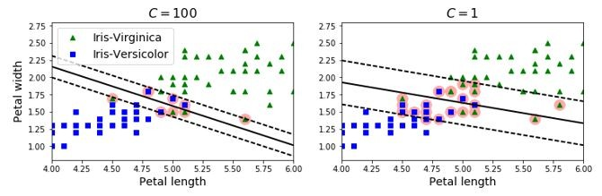
Linear SVM Classification - Soft Margin
We repeat the same model for c = 100 and compare it with c =1

Slide 86
Linear SVM Classification - Soft Margin
Question - What is the model we used here?
SVC (kernel=’linear’, C=1)
SGDClassifier(loss=’hinge’, alpha = 1/(m*c))
LinearSVC

Slide 87
Linear SVM Classification - Soft Margin
Question - What is the model we used here?
SVC (kernel=’linear’, C=1)
SGDClassifier(loss=’hinge’, alpha = 1/(m*c))
Ans: LinearSVC

Slide 88
Linear SVM Classification
Linear SVM Classification
Nonlinear SVM
Classification
SVM
Regression
Bad model versus
good-model (Large Margin) Classification
Soft Margin versus
Hard-margin Classification

Slide 89
Linear SVM Classification
Linear SVM Classification
Nonlinear SVM
Classification
SVM
Regression
Polynomial Features + StandardScal er + LinearSVC
SVC
Polynomial Kernel + Standard Scaler
SVC RBF
Kernel + Standard Scaler

Slide 90
Nonlinear SVM Classification
Many datasets cannot be linearly separable
Approach 1: Add more features as polynomial features
Can result in a linearly separable dataset

Slide 91
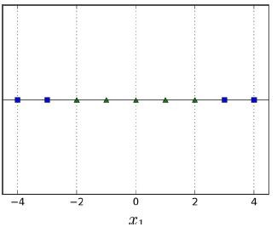
Nonlinear SVM Classification
Approach 1: Add more features as polynomial features
Question - Is this linearly separable?

Slide 92
Nonlinear SVM Classification
Approach 1: Add more features as polynomial features
Question - Is this linearly separable? - No

Slide 93
Nonlinear SVM Classification
Approach 1: Add more features as polynomial features
What if we transform this data and add a new feature that is squared of the original dataset
Original X0 (X1) | Label | X0_new (X2 = X1^2)
-4 | 1 | 16
-3 | 1 | 9
-2 | 0 | 4
-1 | 0 | 1
0 | 0 | 0
1 | 0 | 1
2 | 0 | 4
3 | 1 | 9
4 | 1 | 16

Slide 94
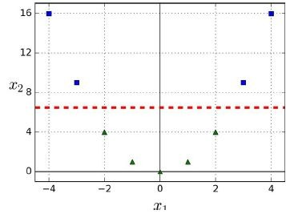
Nonlinear SVM Classification
Approach 1: Add more features as polynomial features
We plot the new feature along with the old feature

Slide 95
Nonlinear SVM Classification
Approach 1: Add more features as polynomial features
Question - Is it linearly separable?

Slide 96
Nonlinear SVM Classification
Approach 1: Add more features as polynomial features
Question - Is it linearly separable? YES

Slide 97
Switch to Notebook

Slide 98
Nonlinear SVM Classification: Example
Approach 1: Add more features as polynomial features
MOONS Dataset
Random dataset generator provided by sklearn library
2d or 2 features
Single Label
Binary Classification

Slide 99


Nonlinear SVM Classification: Example
MOONS Dataset
>>> | from | sklearn.datasets import make_moons
>>> | X, y | = make_moons(n_samples=5, noise=0.15, | random_state=42)
No. of samples
seed
Result:
[[-0.92892087 |  | 0.20526752]
[ 1.86247597 |  | 0.48137792]
[-0.30164443 |  | 0.42607949]
[ | 1.05888696 | -0.1393777 | ]
[ | 1.01197477 | -0.52392748]]
[0 | 1 1 0 1]

Slide 100
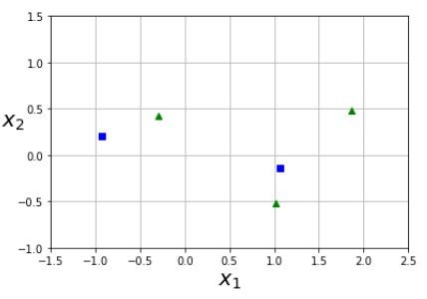
Nonlinear SVM Classification: Example
MOONS Dataset
Result:
[[-0.92892087 |  | 0.20526752]
[ 1.86247597 |  | 0.48137792]
[-0.30164443 |  | 0.42607949]
[ | 1.05888696 | -0.1393777 | ]
[ | 1.01197477 | -0.52392748]]
[0 | 1 1 0 1]

Slide 101
Nonlinear SVM Classification: Example
MOONS Dataset
Similarly generate 100 such samples
>>> | from | sklearn.datasets import make_moons
>>> | X, y | = make_moons(n_samples=100, noise=0.15, | random_state=42)

Slide 102
Nonlinear SVM Classification: Example
MOONS Dataset
Similarly generate 100 such samples
Plotting the dataset
>>> def plot_dataset(X, y, axes):
>>> plt.plot(X[:, 0][y==0], X[:, 1][y==0], "bs")
>>> plt.plot(X[:, 0][y==1], X[:, 1][y==1], "g^")
>>> plt.axis(axes)
>>> plt.grid(True, which='both')
>>> plt.xlabel(r"$x_1$", fontsize=20)
>>> plt.ylabel(r"$x_2$", fontsize=20, rotation=0)
>>> | plot_dataset(X, | y, | [-1.5, | 2.5, | -1, | 1.5])
>>> | plt.show()

Slide 103
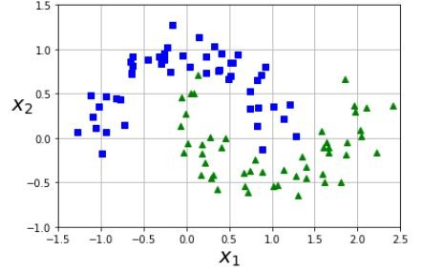
Nonlinear SVM Classification: Example
MOONS Dataset
Similarly generate 100 such samples
Plotting the dataset

Slide 104
Nonlinear SVM Classification: Example
MOONS Dataset
Q. How to classify this using linear classifier?

Slide 105
Nonlinear SVM Classification: Example
MOONS Dataset
Q. How to classify this using linear classifier?
Ans: Add more features as polynomial features

Slide 106
Nonlinear SVM Classification: Example
Adding polynomial features
What does adding polynomial features mean
Let us consider another example
X1 | X2 | Label
-0.083 | 0.577 | 1
1.071 | 0.205 | 0
Degree = 2
1 | x1 | x2 | x1^2 | x1*x2 | x2^2 | Label
1 | -0.083 | 0.577 | 0.007 | -0.048 | 0.333 | 1
1 | 1.071 | 0.205 | 1.147 | 0.22 | 0.22 | 0

Slide 107
Nonlinear SVM Classification: Example
Adding polynomial features
What does adding polynomial features mean
Let us consider another example
>>> from sklearn.preprocessing import PolynomialFeatures
>>> X, y = make_moons(n_samples=2, noise=0.15, random_state=42)
>>> np.set_printoptions(precision=2)
>>> print(X)
>>> print(y)
>>> poly=PolynomialFeatures(degree=3)
>>> x1=poly.fit_transform(X)*100
>>> print(x1)

Slide 108
Nonlinear SVM Classification: Example
Adding polynomial features
What does adding polynomial features mean
Let us consider another example
X = [[-0.08 0.58]
[ 1.07 0.21]]
y = | [1 | 0]
X1 | =
[[ | 1. | -0.08 | 0.58 | 0.01 | -0.05 | 0.33 | -0. | 0. -0.03 0.19]
[ | 1. | 1.07 | 0.21 | 1.15 | 0.22 | 0.04 | 1.23 | 0.24 0.05 0.01]]

Slide 109
Nonlinear SVM Classification: Example
MOONS Dataset
Q. How to classify this using linear classifier?
Ans: Added more features as polynomial features

Slide 110
Nonlinear SVM Classification: Example
MOONS Dataset
Add more features with degree 3
Scale the new features using StandardScaler()
Use SVM Classifier
All the above steps can be performed in a single iteration using a Pipeline

Slide 111
Nonlinear SVM Classification: Example
>>> from sklearn.pipeline import Pipeline
>>> from sklearn.preprocessing import PolynomialFeatures
>>> polynomial_svm_clf = Pipeline((
("poly_features", PolynomialFeatures(degree=3)), ("scaler", StandardScaler()),
("svm_clf", LinearSVC(C=10, loss="hinge"))
))
>>> polynomial_svm_clf.fit(X, y)

Slide 112
Nonlinear SVM Classification: Example
MOONS Dataset
Plotting the dataset along with the classifier (decision boundary) just modeled

Slide 113
Nonlinear SVM Classification: Example
def plot_predictions(clf, axes):
x0s = np.linspace(axes[0], axes[1], 100) x1s = np.linspace(axes[2], axes[3], 100) x0, x1 = np.meshgrid(x0s, x1s)
X = np.c_[x0.ravel(), x1.ravel()]
y_pred = clf.predict(X).reshape(x0.shape)
y_decision = clf.decision_function(X).reshape(x0.shape) plt.contourf(x0, x1, y_pred, cmap=plt.cm.brg, alpha=0.2) plt.contourf(x0, x1, y_decision, cmap=plt.cm.brg, alpha=0.1)
plot_predictions(polynomial_svm_clf, [-1.5, 2.5, -1, 1.5])
plot_dataset(X, y, [-1.5, 2.5, -1, 1.5]) plt.show()

Slide 114
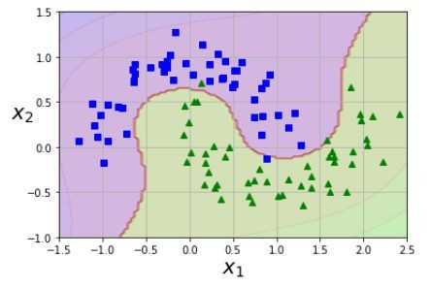
Nonlinear SVM Classification: Example

Slide 115
Switch to Notebook

Slide 116
Linear SVM Classification
Linear SVM Classification
Nonlinear SVM
Classification
SVM
Regression
Polynomial Features + StandardScaler
+ LinearSVC
SVC
Polynomial Kernel + Standard Scaler
SVC RBF
Kernel + Standard Scaler

Slide 117
Nonlinear SVM Classification
Polynomial Kernel
Adding polynomial features works great
Low polynomial degree cannot deal with complex datasets
High polynomial degree makes the model slow due to huge number of features
How to overcome the slowness due to huge features?
Ans: Polynomial Kernels or Kernel trick

Slide 118
Nonlinear SVM Classification
Polynomial Kernel
Adding polynomial features works great
Low polynomial degree cannot deal with complex datasets
High polynomial degree makes the model slow due to huge number of features
How to overcome the slowness due to huge features?
Ans: Polynomial Kernels or Kernel trick
Makes it possible to get the same result as when using high polynomial degree
Without having to add the features which makes the model slow

Slide 119


Nonlinear SVM Classification
Polynomial Kernel in Scikit-Learn
Can be implement in Scikit Learn using SVC Classifier
Without having to use PolynomialFeatures as in LinearSVC
>>> from sklearn.svm import SVC
>>> poly_kernel_svm_clf = Pipeline(( ("scaler", StandardScaler()), ("svm_clf", SVC(
kernel="poly", degree=3, coef0=1, C=5))))
kernel
coef0
controls how much the model is
influenced by high-degree polynomials vs low-degree

Slide 120
Nonlinear SVM Classification
Polynomial Kernel in Scikit-Learn
Training the classifier using higher degree of polynomial features
# train SVM classifier using 10th-degree polynomial kernel (for comparison)
>>> poly100_kernel_svm_clf = Pipeline(( ("scaler", StandardScaler()),
("svm_clf", SVC(kernel="poly", degree=10, coef0=100, C=5))
))

Slide 121
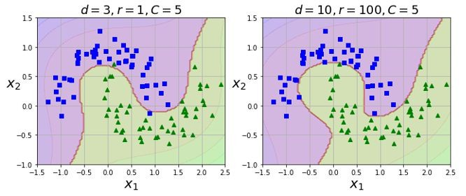
Nonlinear SVM Classification
Polynomial Kernel in Scikit-Learn
Observing the difference in the two cases

Slide 122
Switch to Notebook

Slide 123
Nonlinear SVM Classification
Linear SVM Classification
Nonlinear SVM
Classification
SVM
Regression
Polynomial Features + StandardScaler
+ LinearSVC
SVC
Polynomial Kernel + Standard Scaler
SVC RBF
Kernel + Standard Scaler

Slide 124
Nonlinear SVM Classification - SVC RBF
Adding similar features
Another technique of solving nonlinear classifications
Add features computed using a similarity function
Similarity function measures how each instance resembles a particular ‘landmark’

Slide 125
Nonlinear SVM Classification - SVC RBF
Is this linearly separable? NO

Slide 126
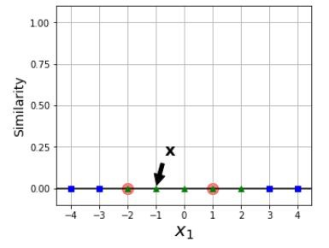
Nonlinear SVM Classification - SVC RBF
Introduce landmarks - x

Slide 127

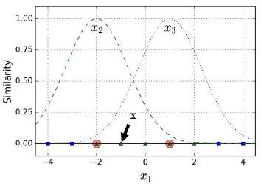
Nonlinear SVM Classification - SVC RBF
Calculate distance using the formula:

Slide 128
Nonlinear SVM Classification - SVC RBF
New features: distances from landmarks x=-2 and x=1
Original X0 (X1) | Label | X2 - distance from Landmark 1 | X3 - distance from Landmark 2
-4 | 1 | 0.3 | 0
-3 | 1 | 0.74 | 0.01
-2 | 0 | 1 | 0.07
-1 | 0 | 0.74 | 0.3
0 | 0 | 0.3 | 0.74
1 | 0 | 0.07 | 1
2 | 0 | 0.01 | 0.74
3 | 1 | 0 | 0.3
4 | 1 | 0 | 0.07

Slide 129
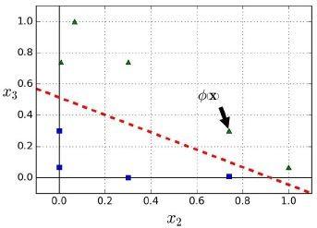
Nonlinear SVM Classification - SVC RBF
Plot the new features and do linear classification

Slide 130
Nonlinear SVM Classification - SVC RBF
Similarity Function: Using SciKit Learn
# define similarity function to be Gaussian Radial Basis Function (RBF) # equals 0 (far away) to 1 (at landmark)
>>> def gaussian_rbf(x, landmark, gamma):
return np.exp(-gamma * np.linalg.norm(x - landmark, axis=1)**2)
>>> | gamma |  | = | 0.3
>>> >>> >>> | x1s x2s x3s | = = = | np.linspace(-4.5, gaussian_rbf(x1s, gaussian_rbf(x1s, |  | 4.5, 200).reshape(-1, -2, gamma) 1, gamma) | 1)
>>> XK = np.c_[gaussian_rbf(X1D, -2, gamma), gaussian_rbf(X1D, 1, gamma)]
>>> yk = np.array([0, 0, 1, 1, 1, 1, 1, 0, 0])
>>> print(XK)

Slide 131
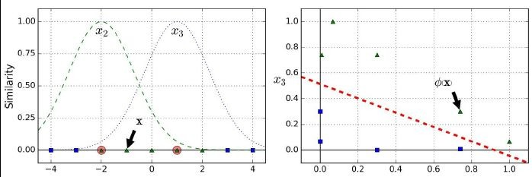
Nonlinear SVM Classification - SVC RBF
Similarity Function: Using SciKit Learn
Upon plotting, the difference can be observed

Slide 132
Switch to Notebook

Slide 133
Nonlinear SVM Classification - SVC RBF
Similarity Function: How to select the landmarks?
Create a landmark at each and every instance of the dataset
Drawback
If training set is huge, number of new features added will be huge

Slide 134
Nonlinear SVM Classification - SVC RBF
Ideally how many new features should be added in this?
Original X0 (X1) | Label
-4 | 1
-3 | 1
-2 | 0
-1 | 0
0 | 0
1 | 0
2 | 0
3 | 1
4 | 1

Slide 135
Nonlinear SVM Classification
Ideally how many new features should be added in this? Ans: 9
Original X0 (X1) | Label
-4 | 1
-3 | 1
-2 | 0
-1 | 0
0 | 0
1 | 0
2 | 0
3 | 1
4 | 1

Slide 136
Nonlinear SVM Classification - SVC RBF
Ideally how many new features should be added in this? Ans: 9
The training set converts into 9 instances with 9 features
Imagine doing this with huge training datasets

Slide 137
Nonlinear SVM Classification - SVC RBF
Gaussian RBF Kernel
Polynomial Feature addition becomes slow with higher degrees
Kernel trick solves it
Similarity function becomes slow with higher number of training dataset
SVM kernel trick again solves the problem

Slide 138
Nonlinear SVM Classification - SVC RBF
Gaussian RBF Kernel
It lets us to get similar results as if
We had added many similarity features
Without actually having to add them

Slide 139
Nonlinear SVM Classification - SVC RBF
Gaussian RBF Kernel in ScikitLean
>>> rbf_kernel_svm_clf = Pipeline(( ("scaler", StandardScaler()),
("svm_clf", SVC(kernel="rbf", gamma=5, C=0.001))
))
>>> rbf_kernel_svm_clf.fit(X, y)

Slide 140
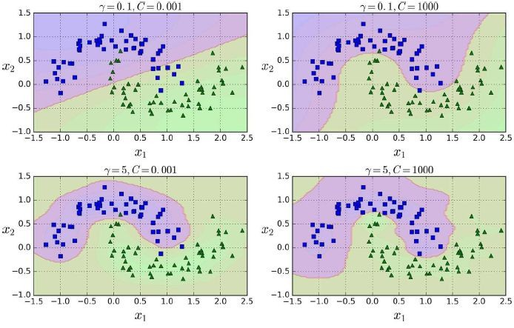
Nonlinear SVM Classification - SVC RBF
Gaussian RBF Kernel in ScikitLearn
Plotting with different hyper parameters

Slide 141
Nonlinear SVM Classification - SVC RBF
Gaussian RBF Kernel in Scikit-Learn
Plotting with different hyper parameters
Increasing Gamma | Small Gamma
Makes bell curve narrower | Makes the bell curve wider
Reduces influence of each instance | Instances have a larger range of influence
Decision boundary becomes irregular | Decision boundary becomes smoother

Slide 142
Switch to Notebook

Slide 143
Computational Complexity
Which kernel to use when?
Linear Kernel First
a. LinearSVC faster than SVC(kernel=’linear’) for large datasets with a lot of features
Gaussian RBF kernel
Other kernels: Cross validation and grid search

Slide 144
Computational Complexity
Linear SVC
Based on liblinear library
Scales linearly with number of instances and number of features
Does not support kernel tricks
Time complexity is: O(m * n)

Slide 145
Computational Complexity
SVC Class
Based on libsvm library
Support kernel tricks
Time complexity is: O(m^2 * n) and O(m^3 * n)
Dreadfully slow when the number of training sets increases
Perfect for complex but small or medium training sets
m = number of training sets
n = number of features

Slide 146
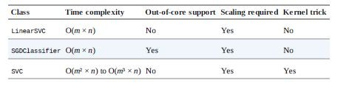
SVM Classification - Comparison
LinearSVC | SVC | SGDClassifier
Fast | Slow for large datasets Perfect for small but complex training sets | Does not converge as fast as LinearSVC but can be useful for datasets that do not fit in memory

Slide 147
Linear SVM Classification
Linear SVM Classification
Nonlinear SVM Classification
SVM
Regression
Polynomial Features + StandardScaler
+ LinearSVC
SVC
Polynomial Kernel + Standard Scaler
SVC RBF
Kernel + Standard Scaler

Slide 148
Linear SVM Classification
Linear SVM Classification
Nonlinear SVM Classification
SVM
Regression
Linear SVM: LinearSVR + Epsilon
Nonlinear
SVM: SVR
Polynomial Kernel + degree + C + epsilon

Slide 149
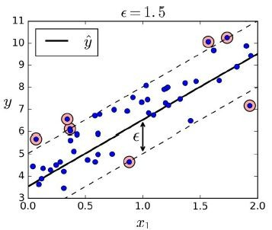


SVM Regression
SVM Classifier | SVM Regression
Find the largest possible street between the two classes limiting margin violations | Fit as many instances as possible on the street while limiting margin violations
Widest possible street

Slide 150
SVM Regression - Linear
Width of the SVM Regression model is controlled by a hyperparameter s
or epsilon.
Adding training instances within the margin does not affect the model’s predictions,
Hence model is said to be s-insensitive

Slide 151
SVM Regression - Linear
Linear Regression in Scikit-Learn: LinearSVR can be used
>>> from sklearn.svm import LinearSVR
>>> svm_reg = LinearSVR(epsilon=1.5)
>>> svm_reg.fit(X, y)

Slide 152
Linear SVM Regression - Example
Linear SVM Regression in Scikit-Learn
Step 1: Generating random numbers and making a linear relationship
>>> from sklearn.svm import LinearSVR
>>> import numpy.random as rnd
>>> import matplotlib.pyplot as plt
>>> rnd.seed(42)
>>> y = (4 + 3 * X + rnd.randn(m,1)).ravel()
>>> plt.scatter(X,y)
>>> plt.show()
>>> | m | = | 50
>>> | X | = | 2 | * rnd.rand(m,1)

Slide 153
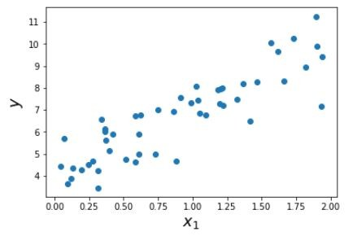
Linear SVM Regression - Example
Linear SVM Regression in Scikit-Learn
Step 1: Generating random numbers and making a linear relationship

Slide 154
Linear SVM Regression - Example
Linear SVM Regression in Scikit-Learn
Step 2: Fitting a linear Support Vector Regression model to the data
>>> from sklearn.svm import LinearSVR
>>> svm_reg1 = LinearSVR(epsilon=1.5)
>>> svm_reg1.fit(X,y)
>>> | x1s | = | np.linspace(0,2,100)
>>> | y1s | = | svm_reg1.coef_*x1s + | svm_reg1.intercept_
>>> plt.scatter(X,y)
>>> plt.plot(x1s, y1s)
>>> plt.show()

Slide 155
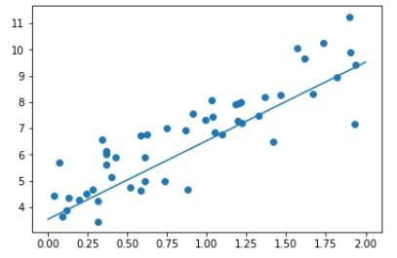
Linear SVM Regression - Example
Linear SVM Regression in Scikit-Learn
Step 2: Fitting a linear Support Vector Regression model to the data

Slide 156
Linear SVM Regression - Example
Linear SVM Regression in Scikit-Learn Step 3: Plotting the epsilon lines
>>> | y1s_eps1 | = | y1s | + | 1.5
>>> | y1s_eps2 | = | y1s | - | 1.5
>>> plt.scatter(X,y)
>>> plt.plot(x1s, y1s)
>>> plt.plot(x1s, y1s_eps1,'k--')
>>> plt.plot(x1s, y1s_eps2,'k--')
>>> plt.xlabel(r"$x_1$", fontsize=18)
>>> plt.ylabel(r"$y$", fontsize=18)
>>> plt.title('eps = 1.5')
>>> plt.show()

Slide 157
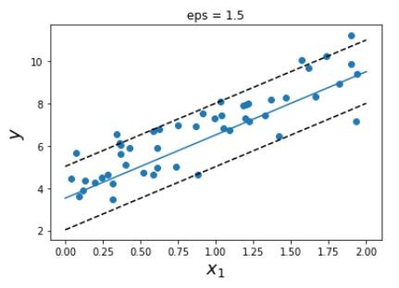
Linear SVM Regression - Example
Linear SVM Regression in Scikit-Learn Step 3: Plotting the epsilon lines

Slide 158
Linear SVM Regression - Example
Linear SVM Regression in Scikit-Learn
Step 4: Finding the support vectors and plotting
>>> y_pred = svm_reg1.predict(X)
>>> | supp_vec_X | = | X[np.abs(y-y_pred)>1.5]
>>> | supp_vec_y | = | y[np.abs(y-y_pred)>1.5]
>>> plt.scatter(supp_vec_X,supp_vec_y)
>>> plt.show()

Slide 159
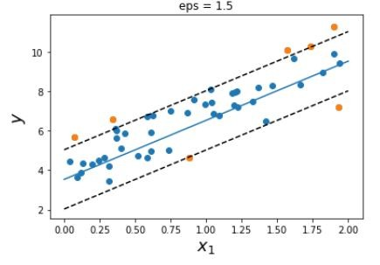
Linear SVM Regression - Example
Linear SVM Regression in Scikit-Learn
Step 4: Finding the support vectors and plotting

Slide 160
Linear SVM Regression - Example
Linear SVM Regression in Scikit-Learn with eps = 0.5
Step 1: Generating random numbers and making a linear relationship
>>> from sklearn.svm import LinearSVR
>>> import numpy.random as rnd
>>> import matplotlib.pyplot as plt
>>> rnd.seed(42)
>>> y = (4 + 3 * X + rnd.randn(m,1)).ravel()
>>> plt.scatter(X,y)
>>> plt.show()
>>> | m | = | 50
>>> | X | = | 2 | * rnd.rand(m,1)

Slide 161
Linear SVM Regression - Example
Linear SVM Regression in Scikit-Learn
Step 1: Generating random numbers and making a linear relationship

Slide 162
Linear SVM Regression - Example
Linear SVM Regression in Scikit-Learn
Step 2: Fitting a linear Support Vector Regression model to the data
>>> from sklearn.svm import LinearSVR
>>> svm_reg1 = LinearSVR(epsilon = 0.5)
>>> svm_reg1.fit(X,y)
>>> | x1s | = | np.linspace(0,2,100)
>>> | y1s | = | svm_reg1.coef_*x1s + | svm_reg1.intercept_
>>> plt.scatter(X,y)
>>> plt.plot(x1s, y1s)
>>> plt.show()

Slide 163
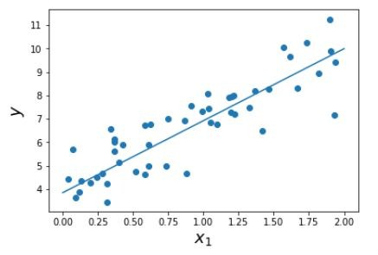
Linear SVM Regression - Example
Linear SVM Regression in Scikit-Learn
Step 2: Fitting a linear Support Vector Regression model to the data

Slide 164
Linear SVM Regression - Example
Linear SVM Regression in Scikit-Learn Step 3: Plotting the epsilon lines
>>> | y1s_eps1 | = | y1s | + | 0.5
>>> | y1s_eps2 | = | y1s | - | 0.5
>>> plt.scatter(X,y)
>>> plt.plot(x1s, y1s)
>>> plt.plot(x1s, y1s_eps1,'k--')
>>> plt.plot(x1s, y1s_eps2,'k--')
>>> plt.xlabel(r"$x_1$", fontsize=18)
>>> plt.ylabel(r"$y$", fontsize=18)
>>> plt.title('eps = 1.5')
>>> plt.show()

Slide 165
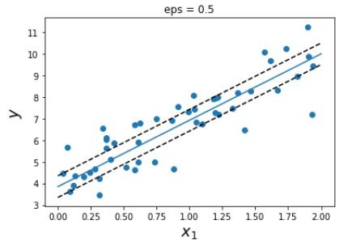
Linear SVM Regression - Example
Linear SVM Regression in Scikit-Learn Step 3: Plotting the epsilon lines

Slide 166
Linear SVM Regression - Example
Linear SVM Regression in Scikit-Learn
Step 4: Finding the support vectors and plotting
>>> y_pred = svm_reg1.predict(X)
>>> | supp_vec_X | = | X[np.abs(y-y_pred)>0.5]
>>> | supp_vec_y | = | y[np.abs(y-y_pred)>0.5]
>>> plt.scatter(supp_vec_X,supp_vec_y)
>>> plt.show()

Slide 167
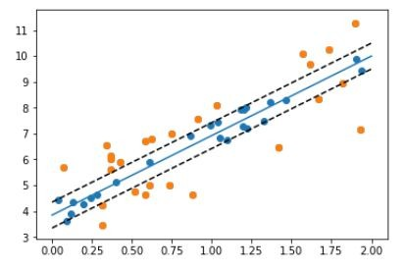
Linear SVM Regression - Example
Linear SVM Regression in Scikit-Learn
Step 4: Finding the support vectors and plotting

Slide 168
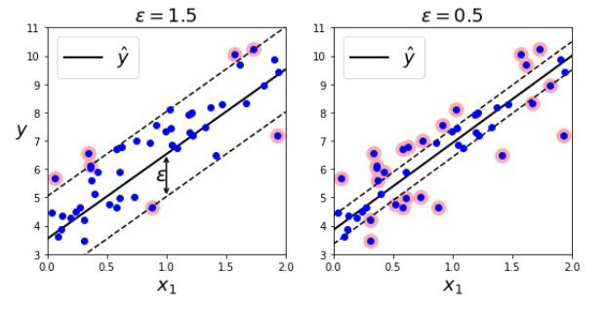
Linear SVM Regression - Example
Linear SVM Regression in Scikit-Learn
Comparison for epsilon = 0.5 and epsilon = 1.5, observations?

Slide 169
Linear SVM Regression - Example
Linear SVM Regression in Scikit-Learn
Comparison for eps = 0.5 and eps = 1.5, observations?
Number of support vectors are higher
Slope is more or less the same
The intercept has changed
Remember: the goal is to maximise the number of training sets within the epsilon line

Slide 170
Linear SVM Classification
Linear SVM Classification
Nonlinear SVM Classification
SVM
Regression
Linear SVM: LinearSVR + Epsilon
Nonlinear
SVM: SVR
Polynomial Kernel + degree + C + epsilon

Slide 171
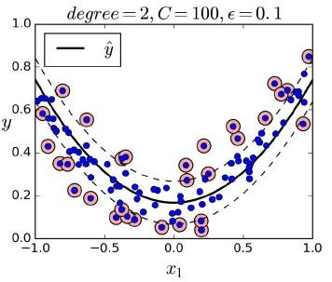
SVM Nonlinear Regression
A ‘kernelized’ SVM Regression model can be used

Slide 172
SVM Nonlinear Regression
A ‘kernelized’ SVM Regression model can be used
C - penalty for being outside the margin or error in classification
Higher C -> Classification: lesser violations, Regression: lesser regularization
Lower C -> Classification: more violations, Regression: more regularization
>>> | from sklearn.svm import SVR
>>> | svm_poly_reg = SVR(kernel="poly", | degree=2, | C=100,
epsilon=0.1)
>>> svm_poly_reg.fit(X, y)
epsilon = margin parameter
C = regularization parameters

Slide 173
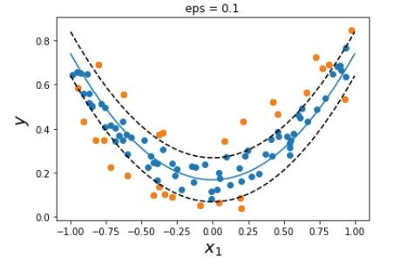
SVM Nonlinear Regression - Example 1
Nonlinear SVM Regression in Scikit-Learn for a quadratic distributed data

Slide 174
SVM Nonlinear Regression - Example 1
Nonlinear SVM Regression in Scikit-Learn
Step 1: Generating random numbers and making a quadratic relationship
>>> >>> >>> | from sklearn.svm import SVR import numpy.random as rnd import matplotlib.pyplot as |  | plt
>>> >>> >>> | rnd.seed(42) m = 100 X = 2 * rnd.rand(m,1) | -1
>>> y = (0.2 + 0.1 * X + 0.5 * X**2 + rnd.randn(m, 1)/10).ravel()
>>> plt.scatter(X,y)
>>> plt.show()

Slide 175
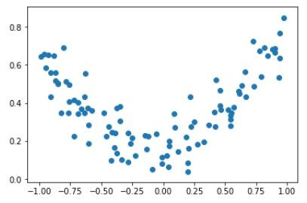
SVM Nonlinear Regression - Example 1
Nonlinear SVM Regression in Scikit-Learn
Step 1: Generating random numbers and making a quadratic relationship

Slide 176
SVM Nonlinear Regression - Example 1
Nonlinear SVM Regression in Scikit-Learn
Step 2: Fitting a Support Vector Regression model (degree=2) to the data
>>> from sklearn.svm import SVR
>>> svr_poly_reg1 = SVR(kernel="poly", degree=2, C = 100, epsilon = 0.1)
>>> svr_poly_reg1.fit(X,y)
>>> print(svr_poly_reg1.C)
>>> x1s = np.linspace(-1,1,200)
>>> plot_svm_regression(svr_poly_reg1, X, y, [-1, 1, 0,
1])

Slide 177
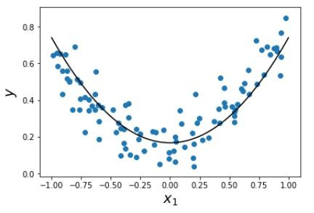
SVM Nonlinear Regression - Example 1
Nonlinear SVM Regression in Scikit-Learn
Step 2: Fitting a Support Vector Regression model (degree=2) to the data

Slide 178
SVM Nonlinear Regression - Example 1
Nonlinear SVM Regression in Scikit-Learn Step 3: Plotting the epsilon lines
>>> | y1s_eps1 | = | y1s | + | 0.1
>>> | y1s_eps2 | = | y1s | - | 0.1
>>> plt.scatter(X,y)
>>> plt.plot(x1s, y1s)
>>> plt.plot(x1s, y1s_eps1,'k--')
>>> plt.plot(x1s, y1s_eps2,'k--')
>>> plt.xlabel(r"$x_1$", fontsize=18)
>>> plt.ylabel(r"$y$", fontsize=18)
>>> plt.title('eps = 1.5')
>>> plt.show()

Slide 179
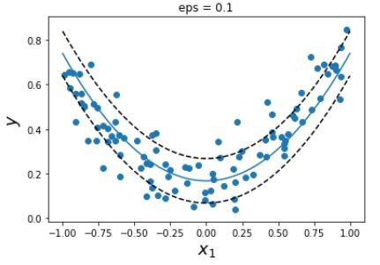
SVM Nonlinear Regression - Example 1
Nonlinear SVM Regression in Scikit-Learn Step 3: Plotting the epsilon lines

Slide 180
SVM Nonlinear Regression - Example 1
Nonlinear SVM Regression in Scikit-Learn
Step 4: Finding the support vectors and plotting
>>> y1_predict = svr_poly_reg1.predict(X)
>>> >>> | supp_vectors_X supp_vectors_y | = = | X[np.abs(y-y1_predict)>0.1] y[np.abs(y-y1_predict)>0.1]
>>> >>> | plt.scatter(supp_vectors_X plt.show() |  |  | ,supp_vectors_y)

Slide 181
SVM Nonlinear Regression - Example 1
Nonlinear SVM Regression in Scikit-Learn
Step 4: Finding the support vectors and plotting

Slide 182
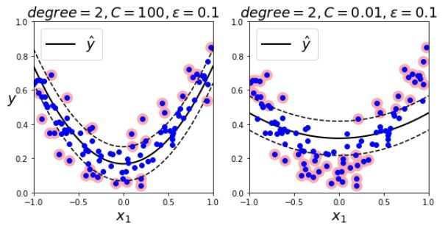
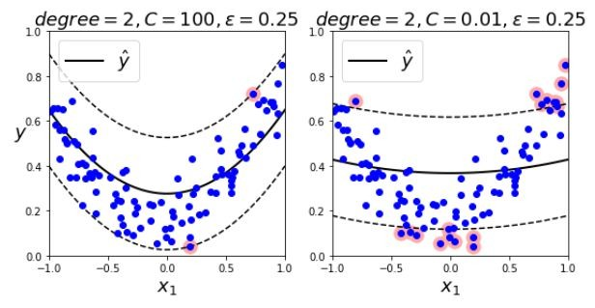
SVM Nonlinear Regression - Comparison

Slide 183
SVM Summary
SVM Classification (Linear and Non Linear)
Bad-model versus good-model: large-margin classification (IRIS Dataset) using SVC
SVM Sensitivity to feature scaling using simple 2d Data using using SVC - StandardScaler
Hard margin versus Soft margin classification (IRIS Dataset) using LinearSVC
Nonlinear SVM Classification using (Moons dataset) LinearSVC, PolynomialFeatures and Standard Scaler
Solving SVM Classification using Kernel Trick - SVC Polynomial Kernel and StandardScaler
Adding similarity features - Gaussian RBF function
Using a Gaussian RBF Kernel - SVC with rbf kernel, StandardScaler
SVM Regression (Linear and Non Linear)
SVM Linear Regression using LinearSVR and controlling the width of the margin using epsilon
Using Kernel-ized SVM Regression model to model non-linear models - SVR with kernel, StandardScaler

Slide 184
How do SVMs work?

Slide 185
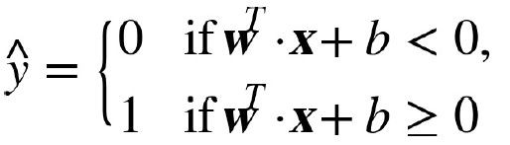
Linear SVM - Decision Functions
Let petal width be denoted by x1 and petal length be denoted by x2.
Decision Function ‘h’ can be defined as w1 * x1 + w2 * x2 + b.
If h < 0, then class=0, else class =1.
It can be represented by the equation below

Slide 186
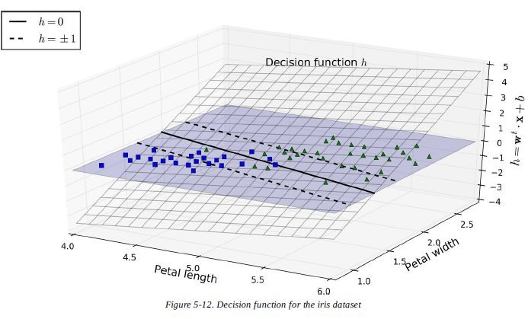
Linear SVM - Decision Functions

Slide 187
Linear SVM - Decision Functions
Training the SVM Classifier would mean:
Finding w and b such that
Margin is as wide as possible while
Avoiding margin violations (hard margin) or
Limiting them (soft margin)

Slide 188
Linear SVM - Decision Functions
Training the SVM Classifier would mean:
Finding w and b such that
Margin is as wide as possible while
Avoiding margin violations (hard margin) or
Limiting them (soft margin)
Q. Remember hard margin and soft margin?

Slide 189
Linear SVM - Decision Functions
Training the SVM Classifier would mean:
Finding w and b such that
Margin is as wide as possible while
Avoiding margin violations (hard margin) or
Limiting them (soft margin)
Q. How do we achieve the above?

Slide 190
Linear SVM - Decision Functions
Training the SVM Classifier would mean:
Finding w and b such that
Margin is as wide as possible while
Avoiding margin violations (hard margin) or
Limiting them (soft margin)
Q. How do we achieve the above?
Optimization

Slide 191
Linear SVM - Decision Functions
What do we know?
For a 2d dataset, the slope of the margin is equal to w = [w1, w2] and the slope of the decision boundary is equal to w1^2 + w2^2
For a n-dimensional dataset, w = [w1, w2, w3, ... , wn] and the slope of the decision function is denoted by || w ||

Slide 192
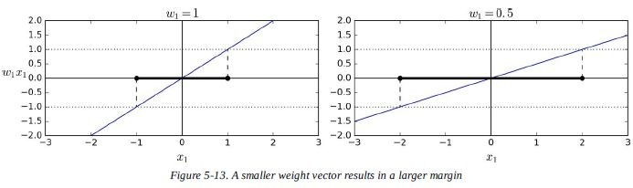
Linear SVM - Decision Functions
What we also know,
- Smaller the weight vector, larger is the margin

Slide 193
Linear SVM - Decision Functions
- So, we can minimize || w || to maximize the margin, can we?

Slide 194
Linear SVM - Decision Functions
So, we can minimize || w ||, to maximize the margin, can we?
No
For hard margin, we need to ensure
Decision function > 1 for all positive training instances
Decision function < -1 for all negative training instances

Slide 195
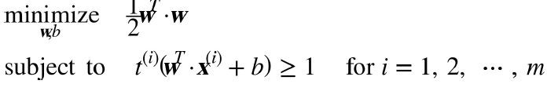
Linear SVM - Decision Functions
So, the problem basically becomes:
Where
t(i) =1 for positive instances and t(i) = -1 for negative instances

Slide 196
Linear SVM - Decision Functions
So, we can minimize || w ||, to maximize the margin, can we?
No
For soft margin, we need to include a slack variable to the minimization equation
Two conflicting goals:
Minimize the weights matrix to maximize the margin
Minimize the slack variable to reduce margin violations
C hyper-parameter allows us to define the trade-off between the two

Slide 197

Linear SVM - Decision Functions
So, the problem for soft-margin basically becomes:
Where
t(i) =1 for positive instances and t(i) = -1 for negative instances

Slide 198
Linear SVM - Decision Functions
Both hard-margin and soft-margin problems are
Convex quadratic problems with
Linear constraints
Such problems are known as Quadratic Programming (QP) problems
Can be solved using off-the-shelf solvers
Using variety of techniques
We will not discuss this in the session

Slide 199
Linear SVM - Decision Functions
So now we know that the hard-margin and soft-margin classifiers
Is a optimization problem to
minimize the cost
given certain constraints
The optimization is a quadratic programming (QP) problem
Which is solved using off-the-shelf solver
Basically, the classifier function is calling a QP solver in the backend to calculate the weights of the decision boundary

Slide 200
Dual Problem
The original constrained optimization problem , known as the primal problem, can be expressed as another closely related problem known as dual problem

Slide 201
Dual Problem
Dual problem gives a lower bound to the solution of the primal problem, but under some circumstances gives the same result.
- SVM problems meet these conditions, hence have same solution for both primal and dual problems.

Slide 202

Dual Problem
Can be expressed as

Slide 203

Dual Problem
Solution from the above dual problem can be transformed to the solution of the original primal problem using:

Slide 204
Dual Problem
Primal Problem | Dual Problem
Slow to solve | Faster to solve than the primal when the number of training instances are smaller than the number of features
Kernel trick is not possible | Hence, making the kernel trick possible

Slide 205
Kernelized SVM
- When did we use SVM Kernel?
- Review (Slides 91 to 125)

Slide 206

Kernelized SVM
When do we use kernelized SVMs?
We applied a 2nd degree polynomial transformation
And then train a linear SVM classifier on the transformed training set

Slide 207
Kernelized SVM
The 2nd-degree polynomial transformed set is 3-dimensional instead of two-dimensional.

Slide 208

Kernelized SVM
If there are two sets of 2-dimensional feature sets, a and b.
We apply 2nd degree polynomial mapping and then compute the dot product of the transformed vectors?
Why do we do this?
The dual problem requires dot product of feature sets

Slide 209
Kernelized SVM
The dot product of transformed vectors
Is equal to the square of the dot product of the original vectors

Slide 210
Kernelized SVM
Each degree transformation requires a lot of computation
Dual problem shall contain dot product of the transformed features matrix
Instead, the original feature can be dot-multiplied and squared
Transformation of the original matrix is not required
The above trick makes the whole process much more computationally efficient

Slide 211

Kernelized SVM
- Kernel function represented by K
- Capable of computing transformed based only on the original vectors without having to compute the transformation.

Slide 212
Online SVMs
What is Online Learning?
Recap: incremental learning of the model as data gathers more datasets on the go

Slide 213

Machine Learning - Online Learning
Machine Learning

Slide 214
Machine Learning - Online Learning
Train system incrementally
By feeding new data sequentially
Or in batches
System can learn from new data on the fly
Good for systems where data is a continuous flow
Stock prices
Machine Learning

Slide 215

Machine Learning - Online Learning
Using online learning to handle huge datasets
Machine Learning

Slide 216
Machine Learning - Online Learning
Using online learning to handle huge datasets
Can be used to train huge datasets
That can not be fit in one machine
The training data gets divided into batches and
System gets trained on each batch incrementally
Machine Learning

Slide 217
Machine Learning - Online Learning
Challenges in online learning
System’s performance gradually declines
If bad data is fed to the system
Bad data can come from
Malfunctioning sensor or robot
Someone spamming your system
Machine Learning

Slide 218
Machine Learning - Online Learning
Challenges in online learning
Closely monitor the system
Turn off the learning if there is a performance drop
Or monitor the input data and remove anomalies
Machine Learning

Slide 219
Machine Learning - Online Learning
Challenges in online learning
Closely monitor the system
Turn off the learning if there is a performance drop
Or monitor the input data and remove anomalies
Machine Learning

Slide 220

Machine Learning - Online Learning
Can be implemented using Linear SVM classifiers
One method is Gradient Descent, e.g SGDClassifier
Cost function can be written as
Machine Learning

Slide 221
Machine Learning - Online Learning
Online Learning can also be implemented using Kernelized SVMs
Currently implemented in Matlab and CPP
For large scale nonlinear problems, we should also consider using neural networks which will be covered in ANN course.
Machine Learning

Slide 222
Archives

Slide 223

Kernelized SVM

Slide 224
Linear SVM Classification
Linear SVM Classification
Nonlinear SVM Classification
SVM
Regression

